Slide 1
REST Connector in the world of IoT
Christof Schwarz
Principal Solution Architect
15-May-2019

Slide 2

Agenda
Don´t rest `till you REST
Introduction to REST
Understand an API
test with 3rd party tool Postman
Working with Qlik REST Connector
Some Qlik Script tricks
Request and use bearer token
ISO-Date handling
Transposing Data
Paging Techniques

Slide 3
What`s out there in the jungle?
Examples of REST

Slide 4
Before we start ...
REST vs SOAP
REST
Representational State Transfer
started to spread in 2005
is a design style
Uses an URI to access information
Many different data formats
SOAP
Simple Object Access Protocol
Is a protocol (“envelope”)
A service interface (calling functions)
More overhead
XML data format
Popularity of REST API in 2019
nREST
nSOAP
nOther

Slide 5
Before we start ...
JSON vs XML
XML
Extensible Markup Language
JSON
JavaScript Object Notation
<?xml version="1.0" encoding="UTF-8"?>
<authentication-context>
<username>my_username</username>
<password>my_password</password>
<id>32443</id>
<validation-factors>
<validation-factor>
<name>remote_address</name>
<value>127.0.0.1</value>
</validation-factor>
</validation-factors>
</authentication-context>
{
"username" : "my_username",
"password" : "my_password",
"id" : 32443,
"validation-factors" : {
"validation-factor" : [
{ "name" : "remote_address",
"value" : "127.0.0.1" }
]
}
}
Strict notation!

Slide 6
Before we start ...
JSON vs XML
XML
Extensible Markup Language
JSON
JavaScript Object Notation
<?xml version="1.0" encoding="UTF-8"?>
<authentication-context>
<username>my_username</username>
<password>my_password</password>
<id>32443</id>
<validation-factors>
<validation-factor>
<name>remote_address</name>
<value>127.0.0.1</value>
</validation-factor>
</validation-factors>
</authentication-context>
{
"username" : "my_username",
"password" : "my_password",
"id" : 32443,
"validation-factors" : {
"validation-factor" : [
{ "name" : "remote_address",
"value" : "127.0.0.1" }
]
}
}
{
username : "my_username",
password : "my_password",
id : 32443,
"validation-factors" : {
"validation-factor" : [
{ name : 'remote_address',
value : '127.0.0.1' }
]
}
}
Strict notation!
Relaxed notation ...

Slide 7
Understand and test the API
Using the tool Postman
Using a tool like Postman

Slide 8
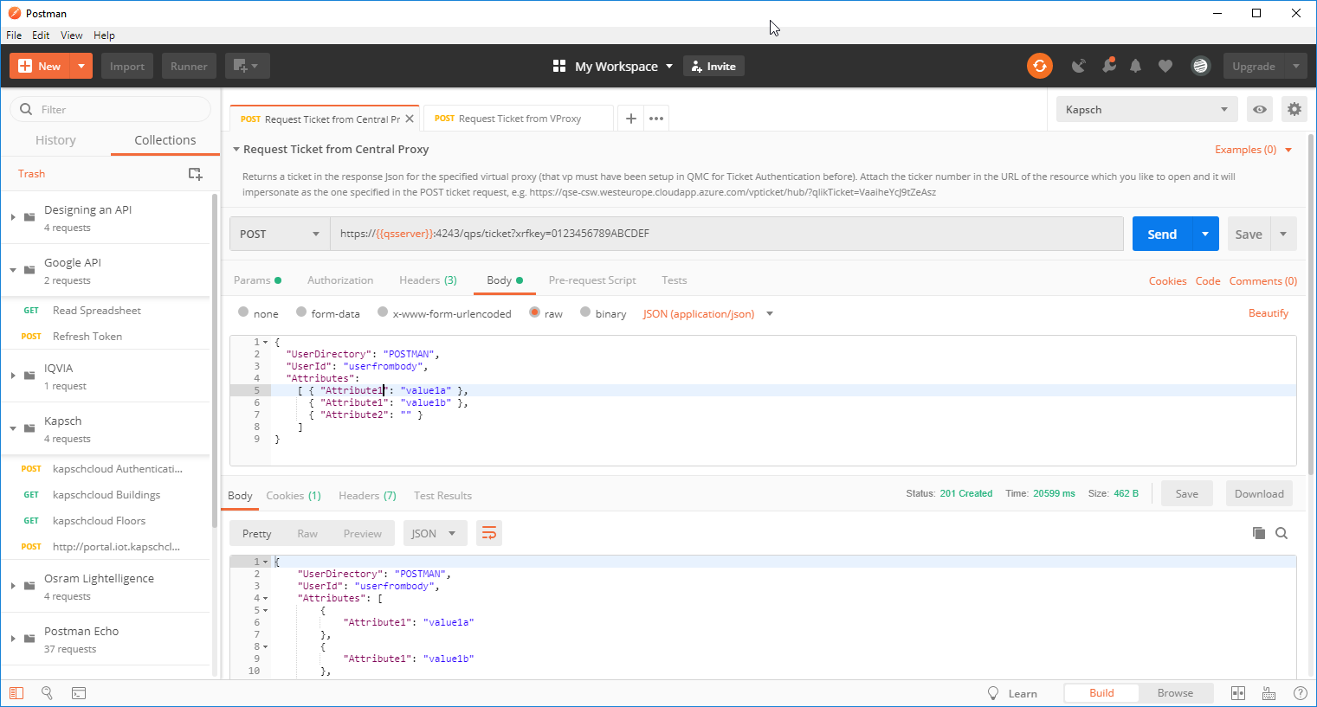
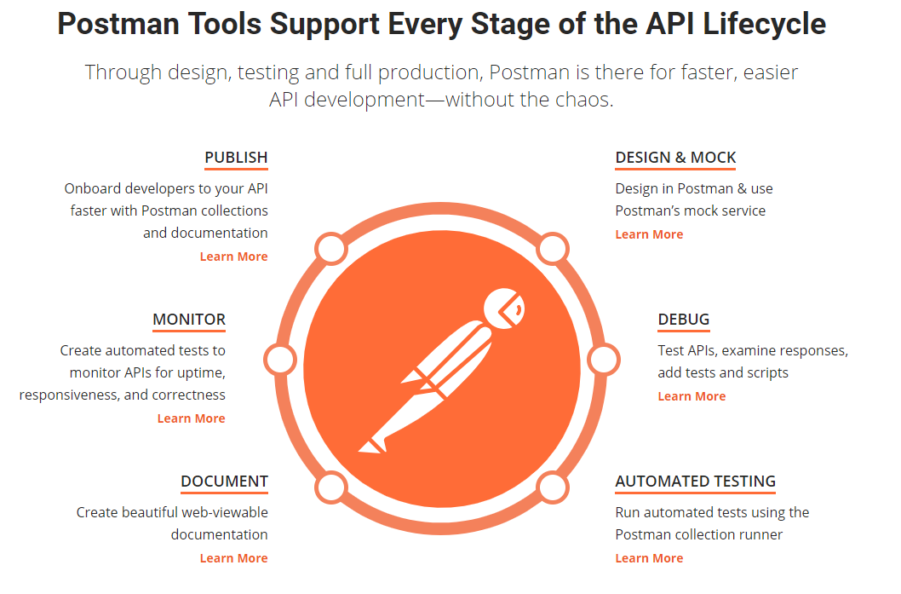
Test with a tool
For example: Postman
www.getpostman.com
Play with API
Echo Server
Mock Server
Copy Code

Slide 9
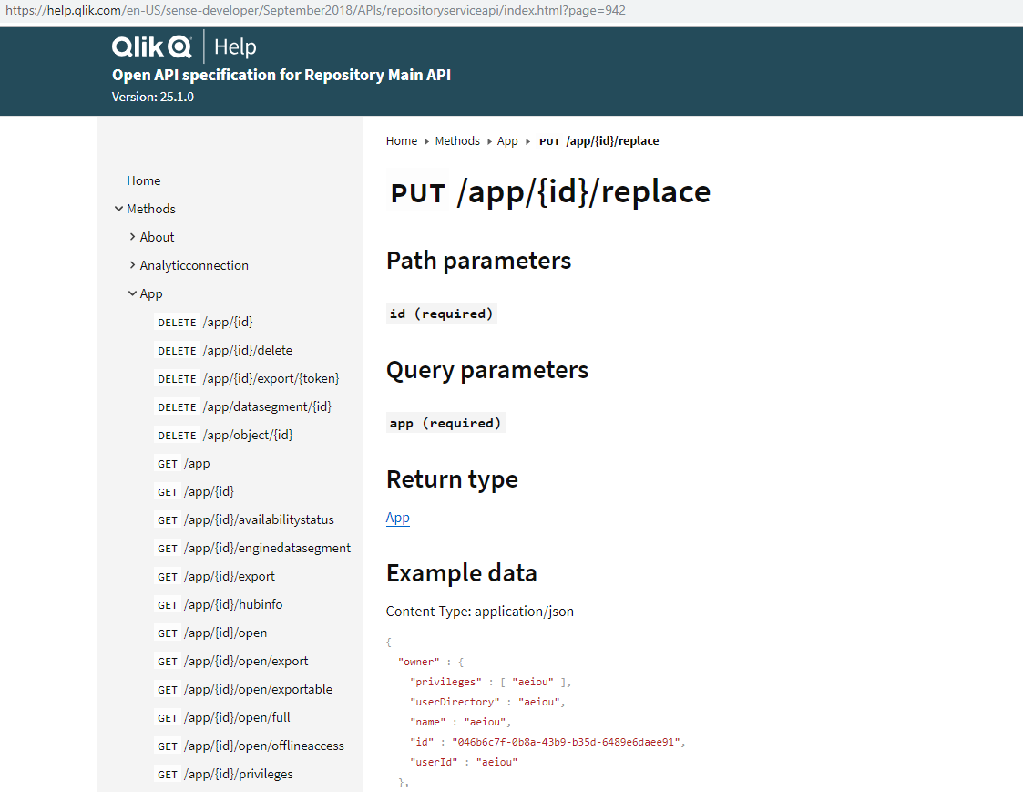
Ask for the documentation, test with a tool
Documention
Describe what methods (endpoints) are doing and which parameters they need
Often created with Swagger
Sending Request
Method (GET, POST, PUT ...)
Path parameters
QueryString parameters
http-headers
Body
Receiving Answer
Response code
Body
Example https://help.qlik.com/en-US/sense-developer/April2019/APIs/repositoryserviceapi

Slide 10
Working with REST APIs

Slide 11

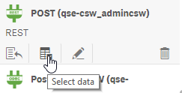
Embrace Qlik Scripting
It takes a program logic to interact with REST APIs
In most cases, it is not a static, single call of a REST URI
The „Select Data“ wizard alone won‘t do the job
A series of calls are needed, which build on each other
Embrace the capabilities of Qlik Scripting
For example
First of all, get a token for the next calls
Make multiple calls since one reply would be too big (paging)
Select Data wizard
+ Scripting
POST
GET
GET
GET
...

Slide 12
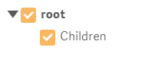
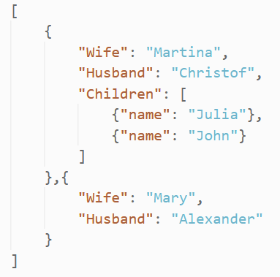
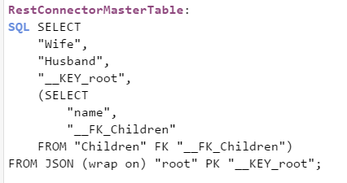
Qlik REST Connector under the hood
De-mystify the generated script
Json Response
REST Connector Wizard
Field names are tolerant. The LOAD doesn‘t break if you attempt to load a non-existing key.

Slide 13
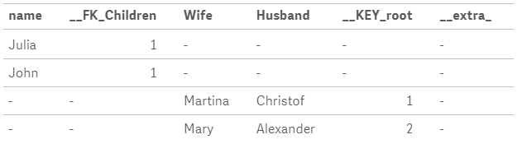
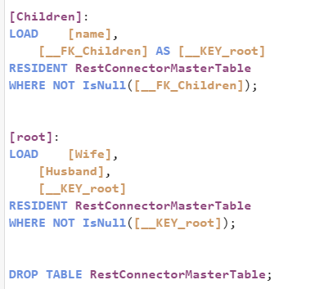
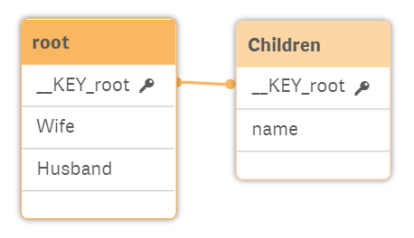
Qlik REST Connector under the hood
RestConnectorMasterTable (temporary)
Final Data Model

Slide 14
Workflow for
working with
REST Connector
First Time
Create generic GET Connection
Create generic POST Connection
Create temp REST Conn to original API
2 golden steps →
Use Add Data Wizard to create script
Add WITH CONNECTION code
Delete temp REST Connection

Slide 15
Workflow for
working with
REST Connector
First Time
Create generic GET Connection
Create generic POST Connection

Slide 16

Set up 2 placeholder REST-connections
Create New Connections in Qlik Sense
Create one placeholder POST request (e.g. https://postman-echo.com/post)
Create one placeholder GET request (e.g. https://postman-echo.com/get)
Leave all params emtpy, you will later parameterize the call with script
Dynamically provide: URL, Query-strings, Http-Header settings, Body
Why two requests?
Because the only thing you cannot parameterize in the call itself is the http-method.
The http-method will come from this script line just before the SELECT ... LIB CONNECT TO 'get_connection'; LIB CONNECT TO 'post_connection';
Note:
The „Create New Connection“ dialog can only be safed when there was a proper REST response

Slide 17
Workflow for
working with
REST Connector
First Time
Create generic GET Connection
Create generic POST Connection
Create temp REST Conn to original API
Use Add Data Wizard to create script
Add WITH CONNECTION code

Slide 18
First Time
Create generic GET Connection
Create generic POST Connection
Create temp REST Conn to original API
SQL SELECT
"__KEY_root",
"rootfield",
(SELECT
"id",
"name",
"__FK_data"
FROM "data" FK "__FK_data")
FROM JSON (wrap on) "root" PK "__KEY_root"
Use Add Data Wizard to create script
WITH CONNECTION (
URL "$(vBaseAPIurl)/users/$(vAPIuserId)"
,QUERY "tenent" "qliktrainees"
,HTTPHEADER "Content-Type" "application/json"
,HTTPHEADER "Authorization" "Bearer $(vToken)"
//,HTTPHEADER "X-HTTP-Method-Override" "PUT",
,HTTPHEADER "cookie" "$(vCookie)"
,BODY "{""path"":""$(vAttribute)""}"
);
Add WITH CONNECTION code
Insert all API parameters
2 golden steps

Slide 19
Part 1/2) Select Syntax
The „Select Data“ Wizard is your friend
J
Temporarily create a third REST connection (POST or GET) and make your way to the response.
If it is complex to the response (e.g. Token will expire soon), use Postman‘s mock server instead
https://xxxxxxxxx-xxxx-xxxx-xxxx-xxxxxxxxxxxx.mock.pstmn.io/<apiendpoint>
No authentication needed
No query-strings, http-header etc. needed
Consistent sample response
You will get a working load script that converts the response (Json, XML, CSV) into Qlik tables
SQL SELECT
"__KEY_root",
"rootfield",
(SELECT
"id",
"name",
"__FK_data"
FROM "data" FK "__FK_data")
FROM JSON (wrap on) "root" PK "__KEY_root"
WITH CONNECTION (
URL "$(vBaseAPIurl)/users/$(vAPIuserId)"
, QUERY "tenent" "qliktrainees"
,HTTPHEADER "Content-Type" "application/json"
,HTTPHEADER "Authorization" "Bearer $(vToken)"
//,HTTPHEADER "X-HTTP-Method-Override" "PUT",
,HTTPHEADER "cookie" "$(vCookie)"
,BODY "{""path"":""$(vAttribute)""}"
);

Slide 20
Part 2/2) Endpoint parameters
SQL SELECT
"__KEY_root",
"rootfield",
(SELECT
"id",
"name",
"__FK_data"
FROM "data" FK "__FK_data")
FROM JSON (wrap on) "root" PK "__KEY_root"
WITH CONNECTION (
URL "$(vBaseAPIurl)/users/$(vAPIuserId)"
,QUERY "tenent" "qliktrainees"
,HTTPHEADER "Content-Type" "application/json"
,HTTPHEADER "Authorization" "Bearer $(vToken)"
//,HTTPHEADER "X-HTTP-Method-Override" "PUT",
,HTTPHEADER "cookie" "$(vCookie)"
,BODY "{""path"":""$(vAttribute)""}"
);
Endpoint documentation is your friend
Add WITH CONNECTION (...) block to the SELECT command code snippet → https://github.com/ChristofSchwarz/qs_script_rest_api
Provide all necessary params to satisfy the API
URL
Query-string(s)
Http-Header(s)
Body
Note: A Json Body has to use two double-quotes for keys and values, because it is already inside a double-quoted string

Slide 21
Workflow for
working with
REST Connector
First Time
Create generic GET Connection
Create generic POST Connection
Create temp REST Conn to original API
Use Add Data Wizard to create script
Add WITH CONNECTION code
Delete temp REST Connection

Slide 22
Workflow for
working with
REST Connector
First Time
Create generic GET Connection
Create generic POST Connection
Complex Request?
Next Time
Y
Use Postman Mock Server
N
Create temp REST Conn to original API
Create temp REST Conn to Mock Server
Use Add Data Wizard to create script
Add WITH CONNECTION code
Delete temp REST Connection

Slide 23
Workflow for
working with
REST Connector
First Time
Create generic GET Connection
Create generic POST Connection
Complex Request?
Next Time
Y
Use Postman Mock Server
N
Create temp REST Conn to original API
Create temp REST Conn to Mock Server
Use Add Data Wizard to create script
Add WITH CONNECTION code
Delete temp REST Connection

Slide 24
Some Qlik Script Tricks
Request and use bearer token,
ISO-Date handling, Transposing Data, Paging

Slide 25
Receiving an access token
And use it as bearer authentication in subsequent calls
1) Get the token
2) Use the token
LIB CONNECT TO 'REST POST Request';
Authentication:
SQL SELECT
"access_token",
"token_type",
"expires_in",
"expiration_time",
"error_message"
FROM JSON (wrap on) "root"
WITH CONNECTION (
URL "$(vBaseAPIurl)/api/Authentication"
,QUERY "username" "#####"
,QUERY "password" "#####"
);
LET vToken = FieldValue('access_token', 1);
DROP TABLE Authentication;
TRACE New Token is $(vToken);
LIB CONNECT TO 'REST GET Request';
RestConnectorMasterTable:
SQL SELECT
...
FROM JSON (wrap on) "root"
WITH CONNECTION (
URL "$(vBaseAPIurl)/api/endpoint"
,HTTPHEADER "Authorization" "Bearer $(vToken)"
...
);
1
2
Even better: Try the old token first, get a new only if the old doesn‘t work anymore → https://github.com/ChristofSchwarz/qs_script_rest_api/blob/master/sub_try_request.md

Slide 26
Date handling
Reading ISO dates
 | 1 | 2 | 3 | 4 | 5 | 6 | 7 | 8 | 9 | 10 | 11 | 12 | 13 | 14 | 15 | 16 | 17 | 18 | 19 | 20 | 21 | 22 | 23 | 24
Field → | 2 | 0 | 1 | 8 | - | 1 | 1 | - | 0 | 1 | T | 1 | 4 | : | 3 | 2 | : | 5 | 1 | Z
Left(field,10) | 2 | 0 | 1 | 8 | - | 1 | 1 | - | 0 | 1
Mid(field,12,6) |  |  |  |  |  |  |  |  |  |  |  | 1 | 4 | : | 3 | 2 | : | 5 | 1

Slide 27
Date handling
Reading ISO dates
 | 1 | 2 | 3 | 4 | 5 | 6 | 7 | 8 | 9 | 10 | 11 | 12 | 13 | 14 | 15 | 16 | 17 | 18 | 19 | 20
Field → | 2 | 0 | 1 | 8 | - | 1 | 1 | - | 0 | 1 | T | 1 | 4 | : | 3 | 2 | : | 5 | 1 | Z
Left(field,10) | 2 | 0 | 1 | 8 | - | 1 | 1 | - | 0 | 1
Mid(field,12,6) |  |  |  |  |  |  |  |  |  |  |  | 1 | 4 | : | 3 | 2 | : | 5 | 1

Slide 28
Date handling
Reading ISO dates
 | 1 | 2 | 3 | 4 | 5 | 6 | 7 | 8 | 9 | 10 | 11 | 12 | 13 | 14 | 15 | 16 | 17 | 18 | 19 | 20
Field → | 2 | 0 | 1 | 8 | - | 1 | 1 | - | 0 | 1 | T | 1 | 4 | : | 3 | 2 | : | 5 | 1 | Z
Left(field,10) ,' | Y | Y | Y | Y | - | M | M | - | D | D | ' | )
Mid(field,12,6) |  |  |  |  |  |  |  |  |  | , | ' | h | h | : | m | m | : | s | s | ' | )
Date#(
Time#(
All together:
Code Snippet → https://github.com/ChristofSchwarz/qs_script_rest_api/blob/master/date_field_processing.md

Slide 29
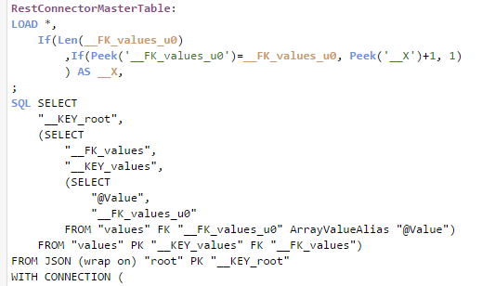

Transposing Arrays
1
1
Introduce a row autoid __X which
restarts at 1 and
increments when the main key is the same as above
1
2
1
3
1
4
1
5
2
1
2
2
2
3
2
4
3
1
3
2
3
3
3
4
3
5
...

Slide 30
Transposing Arrays
1
1
1
2
2
2
3
3
3
4
4
4
5
5
1
1
1
1
1
Use Generic Load to achieve this transpose
2
2
2
2
3
3
3
3
3
GENERIC LOAD
__FK_values_u0, __X, @Value
RESIDENT RestConnectorMasterTable
WHERE __FK_values_u0 > 0;
DROP TABLE RestConnectorMasterTable;

Slide 31
Transposing Arrays
1
1
1
2
2
2
3
3
3
4
4
4
5
5
1
1
1
1
1
Use Generic Load to achieve this transpose
2
2
2
2
3
3
3
3
3
__FieldNames:
MAPPING LOAD * INLINE [
1, Timestamp
2, Passenger
3, From Airport
4, To Airport
5, Date
6, Operator
7, Aircraft Type
] (no labels);
If the field names are not part of the response ...
Script Snippets → https://github.com/ChristofSchwarz/qs_script_rest_api/blob/master/transposing.md
GENERIC LOAD
__FK_values_u0, __X, @Value
RESIDENT RestConnectorMasterTable
WHERE __FK_values_u0 > 0;
DROP TABLE RestConnectorMasterTable;
GENERIC LOAD
__FK_values_u0, ApplyMap('__FieldNames', __X), @Value
RESIDENT RestConnectorMasterTable
WHERE __FK_values_u0 > 0;
DROP TABLE RestConnectorMasterTable;

Slide 32
Transposing Arrays
1
1
1
2
2
2
3
3
3
4
4
4
5
5
1
1
1
1
1
Use Generic Load to achieve this transpose
2
2
2
2
3
3
3
3
3
__FieldNames:
MAPPING LOAD __X, @Value
RESIDENT RestConnectorMasterTable
WHERE __FK_values_u0 = 1 AND Len(@Value);
If the field names are in block 1 of the response
Script Snippets → https://github.com/ChristofSchwarz/qs_script_rest_api/blob/master/transposing.md
GENERIC LOAD
__FK_values_u0, ApplyMap('__FieldNames', __X), @Value
RESIDENT RestConnectorMasterTable
WHERE __FK_values_u0 > 1;
DROP TABLE RestConnectorMasterTable;
GENERIC LOAD
__FK_values_u0, ApplyMap('__FieldNames', __X), @Value
RESIDENT RestConnectorMasterTable
WHERE __FK_values_u0 > 0;
DROP TABLE RestConnectorMasterTable;

Slide 33
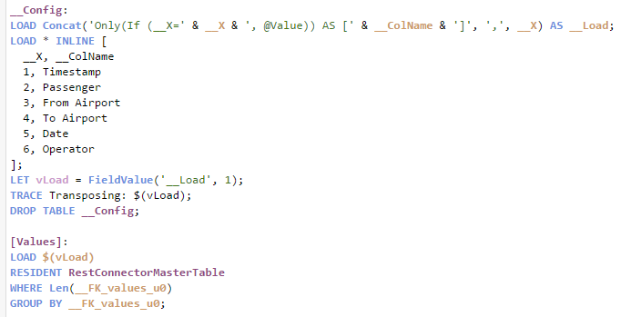
Transposing Arrays
1
1
1
2
2
2
3
3
3
4
4
4
5
5
1
1
1
1
1
Group by the main key and
Load each __X into another column
2
2
2
2
3
3
3
3
3
If the field names are not part of the response ...

Slide 34
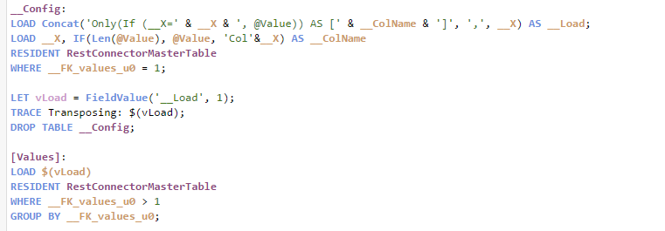
Transposing Arrays
1
1
1
2
2
2
3
3
3
4
4
4
5
5
1
1
1
1
1
Group by the main key and
Load each __X into another column
2
2
2
2
3
3
3
3
3
If the field names are in block 1 of the response

Slide 35
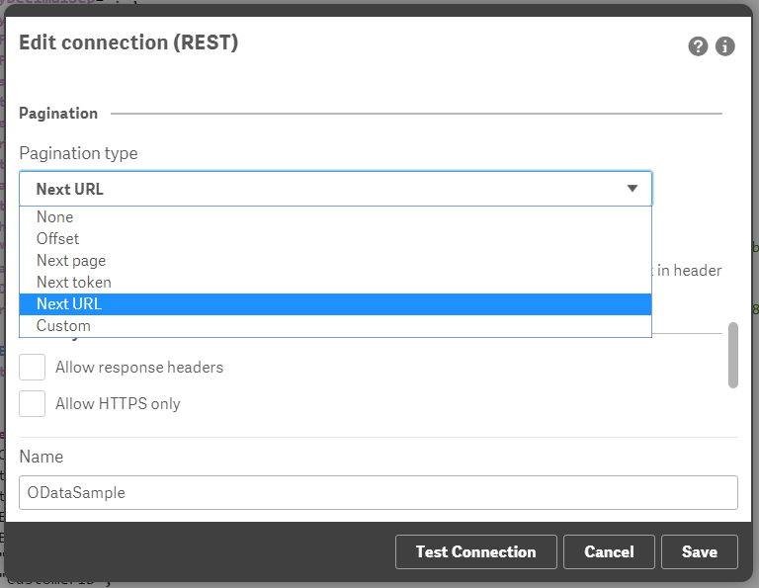
Paging with REST APIs
Built-in paging types
There are some paging strategies supported with no coding, e.g.
BestBuy
Facebook
Google Analytics
REST Connector and Pagination Video (M. Tarallo) https://youtu.be/QlCT55_712I
→ https://help.qlik.com/en-US/connectors/Subsystems/REST_connector_help/Content/Connectors_REST/Create-REST-connection/Pagination-scenarios.htm

Slide 36
Tricks for Paging, OData
OData Standard with "odata.nextLink" and "$skiptoken"
Set Key Generation strategy to „Current Record“
Get the first data page with the REST Connector Wizard.
Before first LOAD block
Create variable and start „DO“ loop
In the first LOAD block
(If missing add "odata.nextLink“)
Add „WITH CONNECTION“ to RestConnectorMasterTable
Before „DROP RestConnectorMasterTable“
Parse the „$skiptoken“ argument from odata.nextLink field
After „DROP RestConnectorMasterTable“
Close „LOOP WHILE“

Slide 37


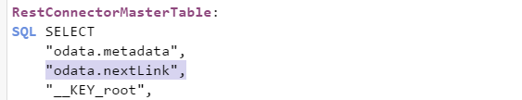

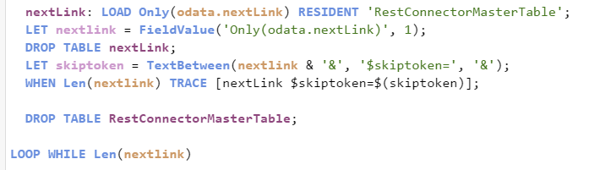
Tricks for Paging
Code Snippets:
https://github.com/ChristofSchwarz/qs_script_rest_api/blob/master/odata.md
OData
Sampe Data:
https://services.odata.org/V3/Northwind/Northwind.svc/Orders?$expand=Order_Details&$format=json
Set Key Generation strategy to „Current Record“
Get the first data page with the REST Connector Wizard.
Before first LOAD block
Create variable and start „DO“ loop
In the first LOAD block
(If missing add "odata.nextLink“)
Add „WITH CONNECTION“ to RestConnectorMasterTable
Before „DROP RestConnectorMasterTable“
Parse the „$skiptoken“ argument from odata.nextLink field
After „DROP RestConnectorMasterTable“
Close „LOOP WHILE“
...
... Other tables like „values“ and „root“

Slide 38
Tricks for Paging
Code Snippets:
https://github.com/ChristofSchwarz/qs_script_rest_api/blob/master/odata.md
OData
Sampe Data:
https://services.odata.org/V3/Northwind/Northwind.svc/Orders?$expand=Order_Details&$format=json
Set Key Generation strategy to „Current Record“
Get the first data page with the REST Connector Wizard.
Before first LOAD block
Create variable and start „DO“ loop
In the first LOAD block
(If missing add "odata.nextLink“)
Add „WITH CONNECTION“ to RestConnectorMasterTable
Before „DROP RestConnectorMasterTable“
Parse the „$skiptoken“ argument from odata.nextLink field
After „DROP RestConnectorMasterTable“
Close „LOOP WHILE“
...
... Other tables like „values“ and „root“

Slide 39
More resources
Help
https://help.qlik.com/en-US/connectors/Subsystems/REST_connector_help/Content/Connectors_REST/Create-REST-connection/Create-REST-connection.htm
Code Snippets
https://github.com/ChristofSchwarz/qs_script_rest_api
https://github.com/ChristofSchwarz/qs_script_rest_api/blob/master/transposing.md
Videos
REST Connector Deluxe (C. Schwarz) https://youtu.be/7m9ZejlzkkY
Qlik and REST (M. Tarallo) https://youtu.be/ibCACdF_tPo
REST Connector and Pagination (M. Tarallo) https://youtu.be/QlCT55_712I
Google Sheet API with Qlik Script (C. Schwarz) https://youtu.be/l9sk-v_PTf8

Slide 40
Thank You

